Slide 1
CS 2200
LAB 4

Slide 2
Today’s Topics
Interrupts,
Performance Metrics

Slide 3
Announcements
Project 1 is due THIS FRIDAY, February 9th at 11:59pm!
If you haven’t started, do it ASAP. You do NOT want to wait until Thursday to start.
This project requires a Demo with a TA, which is a multiplier of your grade
Demo signups will be released on Friday with an announcement on Canvas, and are due by Sunday 11:59 pm
Test 1 is next Wednesday, February 14th in Lab!
Closed book, closed note, Honorlock. Bring your buzzcard
Covers everything up until pipelining.
If you have conceptual questions, ask them before 70% of the questions get released on Sunday night. After this point, TAs can NOT answer any questions about Test 1 related content.
No homework this week, study for the exam!
Notes:
todo fix test 1 announcements(?)

Slide 4
Handling
Interrupts

Slide 5
Review: Types of Discontinuities
Interrupts
Asynchronous events intentionally caused by someone/something interacting with the computer
Ex: Keyboard Press
Traps
Synchronous events that occur when the user accesses protected system resources.
Ex: Memory Allocation
Exceptions
Synchronous event where system encounters something it doesn’t understand, so it purposely sends an alert.
Ex: Null Pointer Exception
Synchronous Events are aligned with “the flow of the system”, occurring at well-defined points that are in-sync with the CPU.
Asynchronous Events are not aligned with the flow of the system, occurring randomly.

Slide 6

Handlers
A handler is simply just a program that deals with an interrupt
When an interrupt/discontinuity is detected, the processor will pause it’s execution of the normal program and run the handler.
OS
INTERRUPT OCCURS
handler

Slide 7
Handlers
Here is very simple handler
{code here for
dealing with the
Interrupt}
PC = value in $k0
// Resumes our original program
$k0 is simply a reserved register for saving the current PC before going to handle the interrupt.
Before a handler is executed, the original PC value is saved in $k0

Slide 8
Handlers
Issue: We need a way to save the state of the processor so we can safely resume our program when the handler is finished. How do we do this?
{code here for
dealing with the
Interrupt}
PC = value in $k0
// Resumes our original program

Slide 9
Handlers
Solution: Save Registers, then restore them! We can save them on the Stack in memory!
Save registers on System Stack
{code here for
dealing with the
Interrupt}
Restore registers on System Stack
PC = value in $k0
// Resumes our original program
Save registers on System Stack
{code here for
dealing with the
Interrupt}
Restore registers from System Stack
PC = value in $k0
// Resumes our original program
Instead of using the regular User Stack (used for function/subroutine calls), we save them to the System (or Kernel) Stack: a stack reserved for the OS specifically.

Slide 10
Handlers
New Issue: What if an interrupt occurs while our Handler Code is executing. $k0 will get overwritten, and lost forever!
Save registers on System Stack
{code here for
dealing with the
Interrupt}
Restore registers on System Stack
PC = value in $k0
// Resumes our original program
If an interrupt occurs here, we will set $k0 to current value of the PC, and jump to the new handler.
When the new handler is finished, we return to our OG handler. However, $k0 was overwritten! We no longer have its original value, and can’t ever exit the OG Handler!
Save registers on System Stack
{code here for
dealing with the
Interrupt}
Restore registers from System Stack
PC = value in $k0
// Resumes our original program

Slide 11


Handlers
New Issue: What if an interrupt occurs while our Handler Code is executing. $k0 will get overwritten, and lost forever!
Save registers on System Stack
{code here for
dealing with the
Interrupt}
Restore registers on System Stack
PC = value in $k0
// Resumes our original program
If an interrupt occurs here, we will set $k0 to current value of the PC, and jump to the new handler.
When the new handler is finished, we return to our OG handler. However, $k0 was overwritten! We no longer have its original value, and can’t ever exit the OG Handler!
Save registers on System Stack
{code here for
dealing with the
Interrupt}
Restore registers from System Stack
PC = value in $k0
// Resumes our original program

Slide 12
Handlers
Solution: Save and restore $k0 on the Stack. This way, if it ever gets overwritten, we can simply reload it!
Save $k0 on System Stack
Save registers on System Stack
{code here for
dealing with the
Interrupt}
Restore registers from System Stack
Restore $k0 from System Stack
PC = value in $k0
// Resumes our original program
Now, if $k0 were ever overwritten here from another Interrupt occurring, it’s not a big deal since we just restore its OG value from the Stack!

Slide 13
Handlers
ANOTHER Issue: If an interrupt occurs while we’re 1) saving or restoring $k0, or 2) jumping back to the original program, then $k0 will get overwritten!
Save $k0 on System Stack
Save registers on System Stack
{code here for
dealing with the
Interrupt}
Restore registers from System Stack
Restore $k0 from System Stack
JALR return
PC = value in $k0
// Resumes our original program
What happens if, while saving $k0, an interrupt occurs! Bye bye $k0
Similarly, what if an interrupt occurs right after we restore $k0? Or if one occurs while setting PC to $k0? It will be overwritten without any backup!

Slide 14
Handlers
Solution: Disable interrupts before executing the handler so we can safely save $k0. Use an atomic RETI Instruction so we can safely jump back!
Save $k0 on System Stack
Enable Interrupts
Save registers on System Stack
{code here for
dealing with the
Interrupt}
Restore registers from System Stack
Disable Interrupts
Restore $k0 from the Stack
RETI
Before we jump to the handler, interrupts are disabled. This way, we can safely jump to the handler and save $k0.
A new RETI instruction makes it so that returning from the Handler and enabling interrupts happen atomically, preventing an interrupt from intervening!

Slide 15
Introducing: The RETI Instruction
The RETI Instruction atomically saves $k0, enables interrupts, and returns to our program. Below is the RETI Instruction
Microcode can’t be interrupted: RETI either executes fully or does not execute at all
RETI
Before jumping to our Handler, we save the previous mode of the Stack (User or Kernel) onto the System Stack.
PC = value in $k0
Restore Mode from System Stack
Enable Interrupts
RETI pops the previous mode from the System Stack and restores it.

Slide 16
Final Handler Procedure & RETI
Handler Procedure
Save $k0 on System Stack
Enable Interrupts
Save registers on System Stack
{code here for
dealing with the
Interrupt}
Restore registers from System Stack
Disable Interrupts
Restore $k0 from the Stack
RETI
RETI
PC = value in $k0
Restore Mode from System Stack
Enable Interrupts

Slide 17
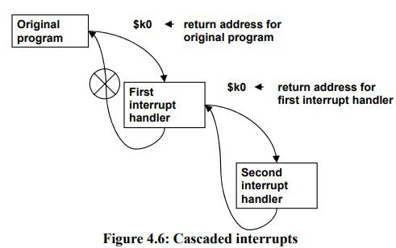
Exercise: Tracing Stack Mode - What happens to the mode in cascaded interrupts?
For each numbered position in the following diagram, write the mode that the processor is currently in:
1.
5.
In the original program
In the first interrupt handler
In the second interrupt handler
After returning back to the first interrupt handler
After returning back to the original program
2.
4.
3.

Slide 18
Exercise: Tracing Stack Mode - What happens to the mode in cascaded interrupts?
For each numbered position in the following diagram, write the mode that the processor is currently in:
User
5.
In the original program
In the first interrupt handler
In the second interrupt handler
After returning back to the first interrupt handler
After returning back to the original program
2.
4.
3.

Slide 19
Exercise: Tracing Stack Mode - What happens to the mode in cascaded interrupts?
For each numbered position in the following diagram, write the mode that the processor is currently in:
User
5.
In the original program
In the first interrupt handler
In the second interrupt handler
After returning back to the first interrupt handler
After returning back to the original program
Kernel
4.
3.

Slide 20
Exercise: Tracing Stack Mode - What happens to the mode in cascaded interrupts?
For each numbered position in the following diagram, write the mode that the processor is currently in:
User
5.
In the original program
In the first interrupt handler
In the second interrupt handler
After returning back to the first interrupt handler
After returning back to the original program
Kernel
4.
Kernel

Slide 21
Exercise: Tracing Stack Mode - What happens to the mode in cascaded interrupts?
For each numbered position in the following diagram, write the mode that the processor is currently in:
User
5.
In the original program
In the first interrupt handler
In the second interrupt handler
After returning back to the first interrupt handler
After returning back to the original program
Kernel
Kernel
Kernel

Slide 22
Exercise: Tracing Stack Mode - What happens to the mode in cascaded interrupts?
For each numbered position in the following diagram, write the mode that the processor is currently in:
User
User
In the original program
In the first interrupt handler
In the second interrupt handler
After returning back to the first interrupt handler
After returning back to the original program
Kernel
Kernel
Kernel

Slide 23
The INT
Macrostate

Slide 24
The INT Macrostate
We now know how to handle interrupts, but…
How should we check if an interrupt occurs?
If an interrupt does occur, how do we find and execute its handler?
Solution: The INT Marcostate!

Slide 25
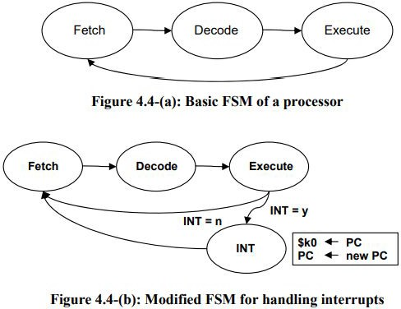
The INT Macrostate
How should we check if an interrupt occurs?
We can check if an interrupt has occurred after an instruction is finished executing
If an interrupt has occurred, we jump to the INT macrostate, which goes to handle interrupts
If not, then we continue to FETCH
Notes:
Note: When it’s actually implemented in real life, we check for interrupts in ifetch1 instead of at the end of every execute state because it saves a clock cycle for each execute <- the alternative (how the LC2200 implements it) is checking for every instruction (instead of going back to fetch, check interrupt, and that microcode will then go back to fetch IF there is no interrupt)

Slide 26
What goes on in the INT Macrostate?
If an interrupt has occurred, we enter the INT Macrostate
During the INT Macrostate, we prepare our processor to jump to the interrupt handler.
We do things like save the PC to $k0, save the previous Stack Mode onto the System Stack, and set the current Stack Mode to Kernel.
Additionally we determine what type of interrupt has occurred, and where in memory is its handler program located

Slide 27
Vectors, the IVT, and the ETR
During the INT Macrostate, how do we determine what type of interrupt has occurred, and where in memory its handler program is located?
Solution: We can assign each interrupt some unique number, then have some kind of table that links each number to its handler program!

Slide 28
Vectors, the IVT, and the ETR
1) Each interrupt is assigned a unique number, called a vector.
You can think of a vector as an interrupt’s ID number
When an interrupt occurs, it gives its vector to the processor
2) When the processor receives an interrupt’s vector, it places it in an Exception/Trap Register (ETR), where its temporarily held.
3) The processor then takes the vector from the ETR and uses it to index into the Interrupt Vector Table (IVT)
The IVT is a region in memory that maps each interrupt’s vector to its handler’s address. You can think: Handler address for interrupt = IVT[vector]
From here, the handler address can be placed in the PC to make the processor jump to the handler.

Slide 29
Vectors, the IVT, and the ETR
Discontinuity Detected
!
Vector of the interrupt placed in the ETR
Vector used to look up address of the handler in the IVT
Processor saves PC to $k0, prepares for handler, then jumps to handler.
handler starts executing
✔
x0107
x0105
x9018
PC = x7621
x0106
x7231
x0107
x7621
x0108
x8390
x0109
x7775
x010A
x9873

Slide 30
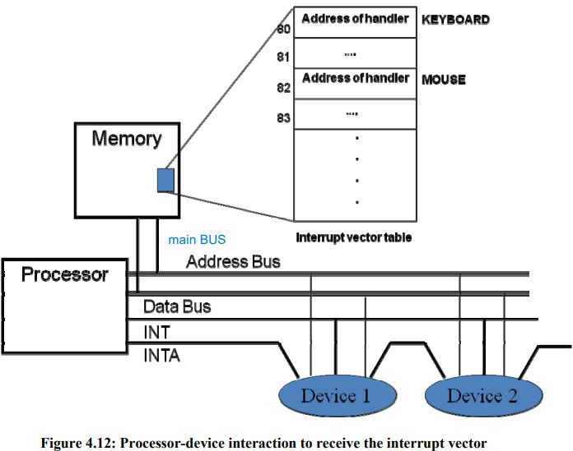
Additional Interrupt Hardware
When a device wants to interrupt the processor, it asserts an INT line
If interrupts are enabled, the processor will recognize this and enter the INT Macrostate
Once in the INT Macrostate, the processor asserts the INTA line
INTA line passes through devices (with daisy chaining) until it reaches the one that’s interrupting
When the INTA line reaches it, the interrupting device outputs its vector to the Data bus, which goes to the processor.

Slide 31
Exercise: Additional Interrupt Hardware
If Device 1 and Device 2 assert the INT bus at the same time, which interrupt will be handled first and why?

Slide 32
Exercise: Additional Interrupt Hardware
If Device 1 and Device 2 assert the INT bus at the same time, which interrupt will be handled first and why?
→ Device 1 will be handled first because of daisy chaining!
Recall: What is daisy chaining?

Slide 33
Final INT Macrostate
INT macrostate:
Save the PC to $k0
Assert INTA
Receive an interrupt’s vector from the Data Bus, place it in the ETR
Use interrupt’s vector to index into IVT to retrieve handler address
PC = Handler address retrieved from the IVT
Save the mode onto the system stack
Switch the mode to kernel if not already in kernel mode
Disable interrupts (DI)
This process successfully identifies which interrupt has occurred, locates its handler, and then jumps to the handler.

Slide 34

Performance
Metrics
Formula Sheet (also found in textbook)

Slide 35
What are Performance Metrics?
Performance metrics provide us with an objective way to analyze a processor or program’s performance.
Generally, we want to optimize space (memory footprint) and time (execution time)
Spatial Metrics: analyze how much memory a program uses
Temporal Metrics: analyze how much time a program takes to execute.

Slide 36
Execution Time
Execution Time is a temporal metric that analyzes how many clock cycles a program takes to execute
CPI = Clock Cycles per Instruction
ex: CPI of ADD on the LC-2200 is 3
CPIAvg is average clock cycles per instruction
n is the number of instructions in the program

Slide 37
Instruction Frequency
Instruction frequency refers to how often an instruction is encountered in a program.
Static Frequency is the number of times an instruction appears in a program (impacts memory footprint)
Appearances of the instruction / Total Instructions
Dynamic Frequency is the number of times an instruction gets executed (impacts execution time)
Number of times an instruction is executed / Total number of instructions executed

Slide 38
Exercise: Instruction Frequency
What might cause static frequency and dynamic frequency differ?

Slide 39
Solution: Instruction Frequency
What might cause static frequency and dynamic frequency differ?
A loop or repeating segment of a program can cause instructions inside the loop/segment to have a higher dynamic frequency (cause they get executed more) than static frequency

Slide 40
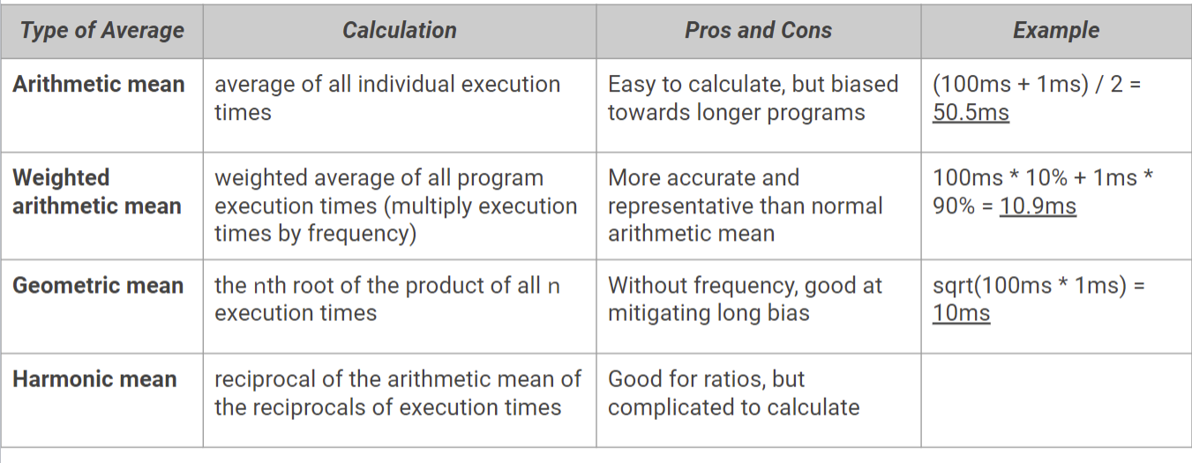
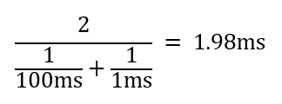

Slide 41
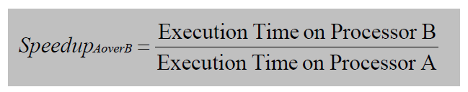
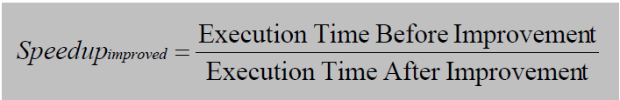
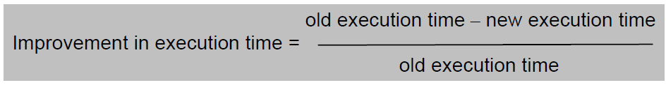
Speedup and Improvement in Execution Time
Speedup
Improvement in execution time

Slide 42


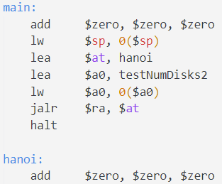
Metrics Exercise
LeBron James’ program is inefficient and has 2,200 instructions, of which:
30% are ADD instructions, of 5 CPI
50% are LW instructions, of 4 CPI
20% are SW instructions, of 4 CPI
Each clock cycle is 8ns (nanoseconds). Bron found a way to improve ADD to 3 CPI. What is the execution time before and after? What is the Speedup and Improvement in execution time of King James’ program?

Slide 43
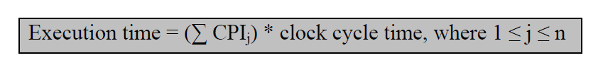
Metrics Exercise Answer
Original:
2200 instructions
8ns clock time
30% ADD instructions, of 5 CPI
50% LW instructions, of 4 CPI
20% SW instructions, of 4 CPI
Old execution time =

Slide 44
Metrics Exercise Answer (cont.)
New:
2200 instructions
8ns clock time
30% ADD instructions, of 3 CPI
50% LW instructions, of 4 CPI
20% SW instructions, of 4 CPI
New execution time =

Slide 45
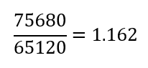
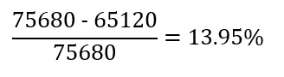
Metrics Exercise Answer (cont.)
Old execution time = 75680ns
New execution time = 65120ns
Speedup =
Improvement in execution time =
Speedup and Improvement in execution time are ratios and DO NOT HAVE UNITS

Slide 46
Amdahl’s Law
Exercise:
A processor spends 30% of its time on add instructions. An engineer proposes to improve the add instruction by 5 times. What is the speedup achieved because of the modification?

Slide 47
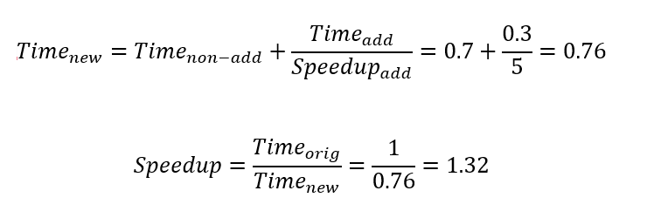
Exercise Answer
Q) A processor spends 30% of its time on add instructions. An engineer proposes to improve the add instruction by 5 times. What is the speedup achieved because of the modification?
Let the original execution time be 1. The amount of time spent on add instructions will be 0.3, and time spent on the remaining instructions will be 0.7. By Amdahl’s Law:

Slide 48
Latency and Throughput
Latency
How many units of time it takes an instruction to execute from start to finish.
Throughput
Number of instructions executed by the processor per unit of time

Slide 49
Thanks for Attending :)
If you have questions about Project 1 or Test 1,
feel free to stick around and ask us!

